Slide 1

PenTesting WiFi Networks and Connected Devices
Dylan Strube and Grant Trotter

Slide 2

Disclaimer
All networks and devices PenTested were personally owned by all group members.

Slide 3
WiFi Hacking Tools
Bettercap
Kali Linux
Alternatives
Nessus
WireShark
BeEF
Aircrack-ng

Slide 4
WiFi Security Basics
WEP is the former standard for WiFi security, but because of many vulnerabilities found within it, the standard has been changed to WPA/WPA2
The type of security a network uses does not matter if it has a weak password.

Slide 5
Wifi Tools Breakdown
Aircrack-ng: Contains tools that assess WiFi security, focusing more on the monitoring, attacking, testing and password cracking.
For our initial Demonstration we planned on using aircrack-ng to monitor our local network and attack a targeted device on said network. Our focus would have been the vulnerabilities of a device and its network.
However, we found our local networks to be more secure than anticipated, and bettercap would be a better tool to exploit them

Slide 6
WiFi Tools Breakdown
Bettercap: This tool is considered a “does it all” or a “Swiss Army knife” of WiFi, Bluetooth and IPv4/IPv6 network reconnaissance.
For our demonstration we will use bettercap to sniff data from our local network and then target a device on the network and exploit it using DNS spoofing to cause the device to go to a web app containing notional malware.

Slide 7
Demonstration Walkthrough
Using a Kali Linux VM, we will use bettercap to locate local networks
After targeting a specific network, we will access a network device’s IP, and use it to sniff for network data.
With this data we can see the devices frequented domains, and use them to further exploit the device.
We will then run a web app, and redirect dns traffic from the target device to our designed web app containing malware.
From there, the device is under our influence

Slide 8
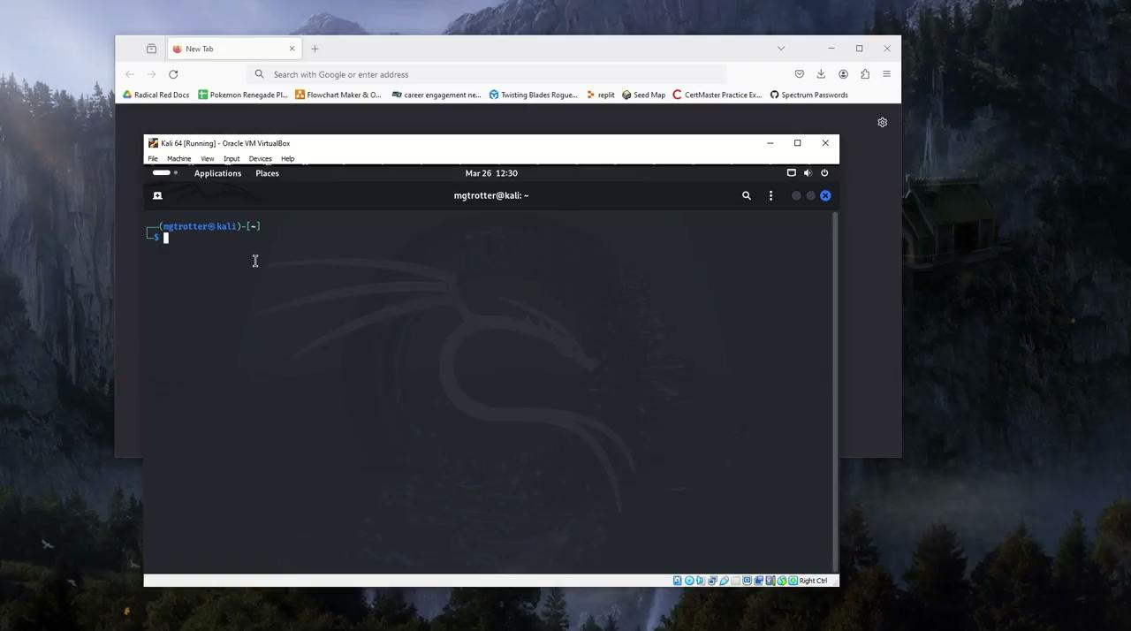
Demonstration

Slide 9
Effects of the Attack
We discovered that the network did not have any direct vulnerabilities with aircrack-ng.
We were able to successfully redirect DNS traffic from targeted device to our web app containing malware.

Slide 10
Vulnerabilities Found
Users on the network are very exploitable using PenTesting tools.
Devices on the network are susceptible to DNS spoofing

Slide 11
Mitigations
Personal firewalls to prevent eavesdropping and packet sniffing
VPN’s are a good way to protect your local network
Internet providers can use DNSSEC to encrypt DNS data
DNS filtering services to prevent known malicious and unwanted content.

Slide 12
Bibliography
Easy and Better Man-In-The-Middle Using Bettercap - CYBERVIE
https://github.com/rerange/aircrack/blob/master/wordlist.txt
https://www.proofpoint.com/us/threat-reference/dns-spoofing

